Slide 1
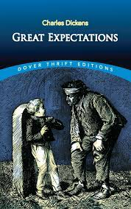
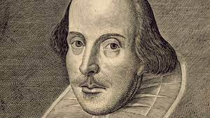
Our English Learning Journey
AO1 | AO2 | AO3 | AO4 | AO5 | AO6 | AO7 | AO8 | AO9
v
The Future
Y13
On-going Revision based on identified areas and
Life Skills in Literacy
Students continuing on with their English studies will complete a program of study that will enable them to ‘Step Up to GCSE.’
Stepping Stone courses – such as Functional Skills – will form a Pathway where students can build the skills, resillience and confidence needed on their journey towards GCSE.
Life Skills Literacy
v
Skills and Assessment
Y12
Purposeful Words
Getting Creative
It’s all about Perspective
Life Skills Literacy
Life Skills Literacy
Life Skills Literacy
Life Skills Literacy
Novel: Part 2
v
Skills and Assessment
Novel: Part 1
It’s all about Perspective
Getting Creative
Purposeful Words
Y11
Novel: Great Expectations
Entry Level Certificate and unit awards (some students)
Literary Heritage: pre and post 1914 poetry
v
Shakespeare: Twelfth Night
S&L
Non- Fiction: respond and create
Fiction: respond and create
Writing Creatively and Convincingly
Y10
Entry Level Certificate and unit awards (some students)

Slide 2
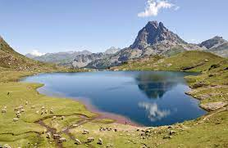
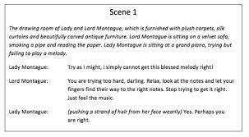
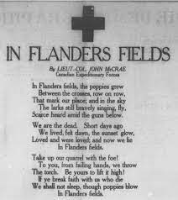
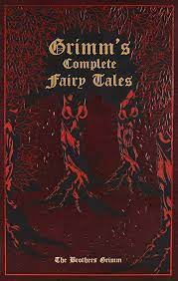
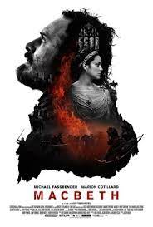
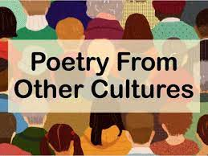
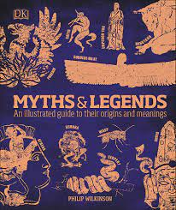
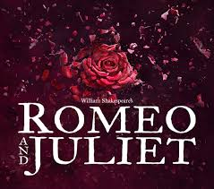
Our English Learning Journey
Transition
to
KS4
v
AO1 | AO2 | AO3 | AO4 | AO5 | AO6 | AO7 | AO8 | AO9
Class Novel
v
Modern Living: Spoken Language
Fighting for Freedom
Play Study
War Poetry: pre and post 1914
The Great Outdoors
Y9
Class Novel
v
Poetry from other Cultures
Y8
Grimm’s Fairytales
The Power of Persuasion
Shakespeare: Macbeth
Disasters!
Moving on
Poetry
v
Class Novel
Shakespeare: Romeo and Juliet
Stop the Press!
Myths and Legends
Y7

Slide 3
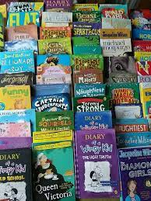
Our English Learning Journey
AO1 | AO2 | AO3 | AO4 | AO5 | AO6 | AO7 | AO8 | AO9
Word Reading | Transcription | Spoken Language
Comprehension | Composition
SPAG | Handwriting
Transition
to
KS3
v
Summer
Fiction: Quest stories
Non-Fiction: Explanatory texts
Poetry: Really Looking poems
Spring
Fiction: Stories on a theme
Non-Fiction: Information texts
Poetry: theme poems
FFT Success for all Phonics
Our Primary
Journey
v
Autumn
Fiction: Stories with a familiar setting
Non-Fiction: Instructive texts
Poetry: sensory poems
At the Seaside
All About Me
Into
The Woods
v
Superheroes
Down on the Farm
Pesky
Pirates
Little Blossoms
Attention and Understanding | Language and Communication | Reading | Writing

Slide 4
Our English Learning Journey
AO1 | AO2 | AO3 | AO4 | AO5 | AO6 | AO7 | AO8 | AO9
Students in our 3 x nurture groups will have tailored access to the relevant national curriculum skills for their age/ ability level. This will help grow confidence and skill and give time to relate and apply the learning to real life situations and life skills.
Following the relevant curriculum will also allow learners in N1 to reintegrate to the whole school in the future.
Life Skills are at the core of chosen topics to facilitate a functional curriculum for these students whilst allowing them to access the key skills needed to gain English qualifications appropriate to their ability, ranging from Unit Awards to Functional Skills.
N1: Spoken Language
N2: Introduction to Shakespeare
N1: Poetry
AND
Spoken Language Projects
N1: Shakespeare Study
N3: Introduction to Shakespeare
N2: Spoken Language
N2: Novel Study
AND
Spoken Language Projects
N3: Poetry > pre and post 1914
N3: Our Future
FFT Success for all as needed
N1: Fiction > Read and Create
N1: Novel Study
N2: Travel Writing
AND
Spoken Language Projects
N2: Non-Fiction > Read and Create
AND
Spoken Language Projects
N3: Writing Creatively and Convincingly
AND
Spoken Language Projects
N3: Non-Fiction > Respond to and create
AND
Spoken Language Projects
N1: Non-Fiction > Read and Create
v
N2: Short Stories and Poetry
AND
Spoken Language Projects
Nurture
N3: Novel Study
AND
Spoken Language Projects

