Slide 1
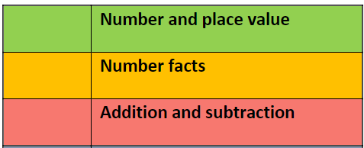
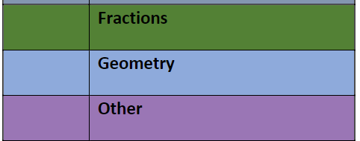
Maths at Northcott
Our Learning Journey
Transition
Calculating using knowledge of structures
Multiplication and division
Multiples of 1000
Statistics
Order of operations
Mean
Ratio and proportion
Solving problems with two unknowns
Numbers up to 10,000,000
Draw, Compose and decompose shapes
Area perimeter, position and direction.
Fractions and percentages
Y6
Fractions
Calculating with decimal fractions
Factors, multiples and primes.
Short Multiplication and division
Negative Numbers
Money
Converting Units
Area and Scaling
Angles
Decimal fractions
Y5
Review of column addition and subtraction
Numbers to 10,000
Perimeter, Coordinates
Symmetry in 2D shapes.
3,6,7,9 times tables
Multiplicative relationships
Patterns
Division with remainders
Review of fractions
Fractions greater than 1
Time
Y4
Time
Unit and non-unit fractions
Manipulating the additive relationship and securing mental calculation
Column + and -
Right angles
Parallel and perpendicular sides in polygons
Numbers to 1000
Adding and subtracting across ten
Numbers to 1000
2,4,8 times tables
Y3
Numbers 10 to 100
Calculations within 20
Addition and subtraction of two-digit numbers
Fluently add and subtract within 10
Intro to multiplication and division structures
Doubling and halfling
Shape
Sense of measure
Money, Time, Fractions, position and direction.
Y2
Position and direction
Time
Unitising and coin recognition
Addition and subtraction facts within 10
Additive structures
Recognise, compose, decompose and manipulate 2D and 3D shapes
Numbers 0-20
Comparison of quantities
part–whole relationships
Y1
Cardinality and Counting
Comparison
Composition
Pattern
Shape and Space
Measures
Little
Blossoms

Slide 2
Maths at Northcott
Our Learning Journey
Number
Algebra
Ratio & Proportion
Probability & Statistics
Geometry
HE
Algebra, Graphs & Sequences review
Geometry review
Review & Revision for GCSE MATHS and STATISTICS
From Class mocks PLC
Y13
GCSE resit or steppingstone qualifications – All students will undertake maths life skills and unit awards
Comparing Data
Geometrical Reasoning
Ratio & Proportion 3
Measures & Accuracy
Equations, Inequalities & Graphs
Numerical Reasoning
GCSE resit or steppingstone qualifications – All students will undertake maths life skills and Unit awards
Y12
Extra Higher Content
Algebra, Graphs & Sequences or review
Advanced Geometry or review
Review & Revision for GCSE MATHS and STATISTICS
From Class mocks PLC
Y11
Entry Level Certificate and unit awards (some students)
Comparing Data
Geometrical Reasoning
Ratio & Proportion 3
Measures & Accuracy
Equations, Inequalities & Graphs
Numerical Reasoning
Entry Level Certificate and unit awards interleaved (some students)
Y10
Factors, Primes & Indices
Formulae & Manipulation
Proportional Relationships
Congruence, Similarity & Constructions
Quadratics & Graphs
Inferences from Data
Y9
Analysing Data
Ratio & Proportion 2
Ratio & Proportion 1
Shape & Construction
Describing with Algebra
Properties of Numbers
Y8
Addition & Subtraction
Multiplication & Division
Angles
Parts of a Whole
Algebraic Reasoning
Units & Measure
Y7

Slide 3
Maths at Northcott
Our Learning Journey
Properties of Number 1
The four operations 2
Ratio 3
Money 4
The Calander and time 5
Measures 6
Geometry 7
Statistics 8
Nurture Curriculum
Maths KS4
Level 1
Classwork and / or controlled assessment
Level 2
Classwork and / or controlled assessment
Level 3
Classwork and / or controlled assessment

Slide 4
Maths at Northcott
Our Learning Journey
EYFS
Primary
Nurture Maths
Secondary Maths
Intervention
Nurture Curriculum
Nurture 1
Students in Nurture 1 will access the curriculum that is most appropriate for them. This will often include lots of manipulatives and practical/sensory input. By accessing the correct curriculum in N1 students can be successful at transitioning back into the main school when this is appropriate. KS4 Students will have an opportunity to work towards a qualification at their level.
Nurture 2
Students will access the Primary and EYFS curriculum to continue to build skills and follow their maths learning journey at their pace.
Nurture 3
Students will follow the nurture curriculum with the option of completing an Entry Level Certificate and/ or Unit Awards to suit their individual needs and ability.

